Slide 1



6 JULY 2011

Slide 2
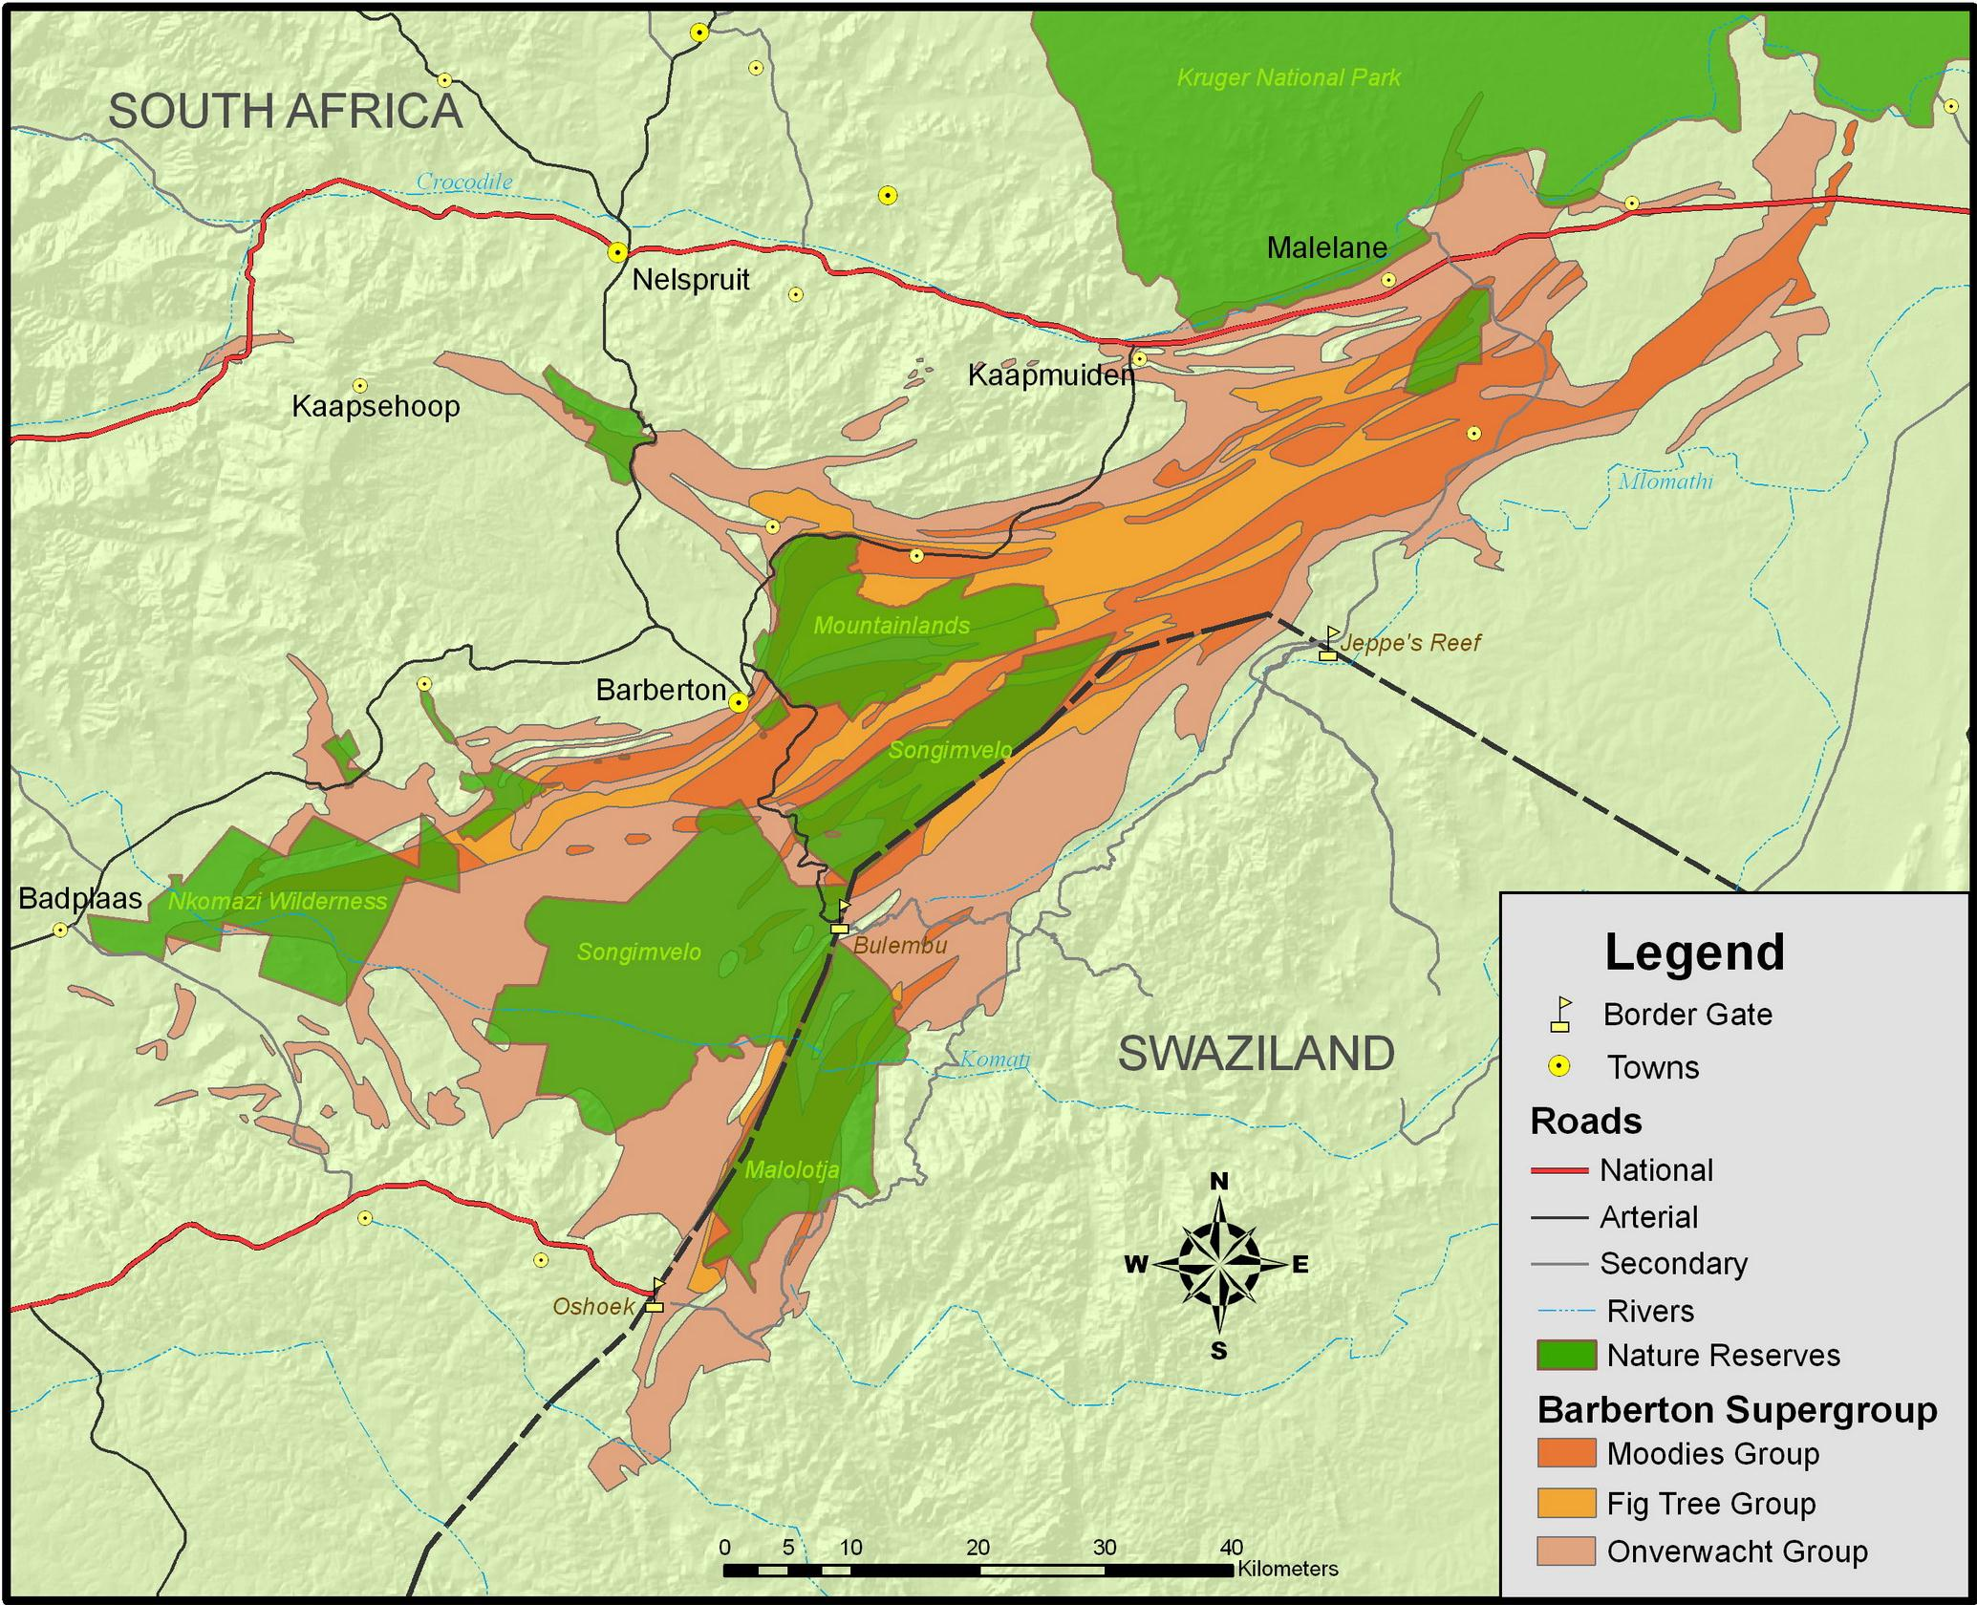

Slide 3
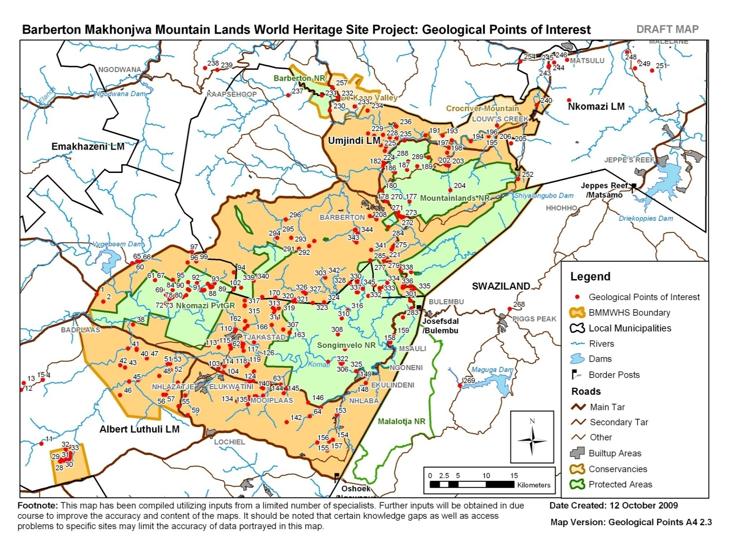

Slide 4
Overview of BATOBIC Projects
Construction of the Bulembu Road – R167 000 000 – Completed 2009
The Barberton Tourism and Biodiversity Corridor (BATOBIC) is a programme with the objective of developing sustainable nature based, adventure and cultural tourism within the region;
BATOBIC is responsible for coordinating the implementation of a number of projects, funded by the National Dept. of Tourism in aid of poverty relief. These include:
    Institutional Strengthening of BATOBIC;
    3 TOURISM ROUTE PROJECTS
    Tourist Route Development & Marketing;
    Signposting & beautification of 2 main Umjindi access intersections;
    Development of Bulembu Road Geotrail;
    OTHER PROJECTS
    Cultural Heritage town enhancement programme.
    Development of 1st phase Bio Park & Visitor Info Centre;
    Lomshiyo Trust Lodge Development;
Further projects & interventions identified from strategy

Slide 5
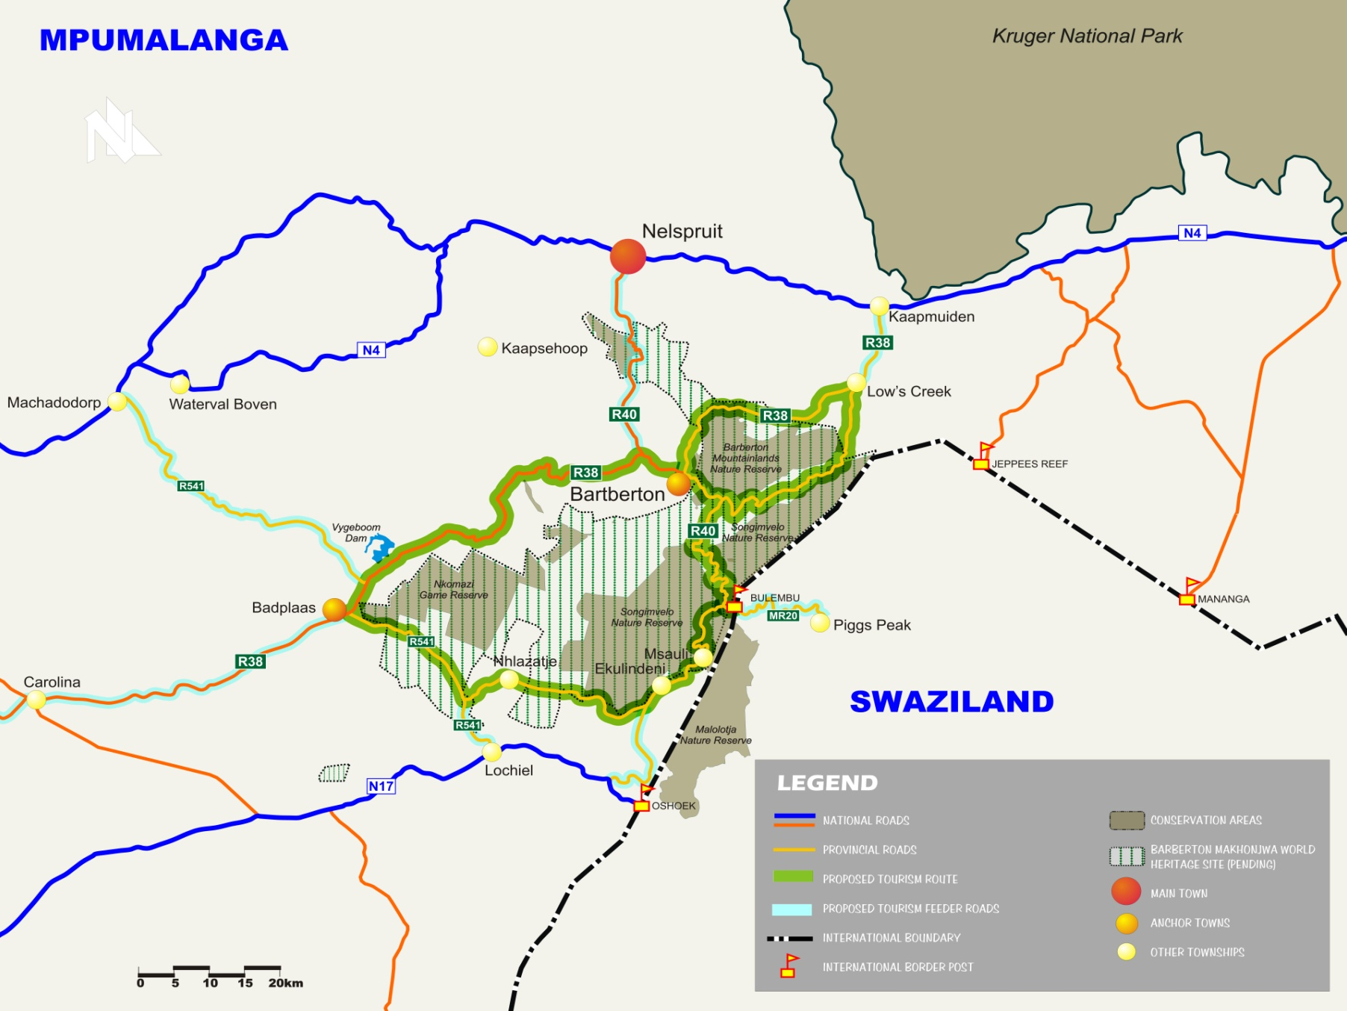
3 projects
BARBERTON GATEWAYS
GENESIS ROUTE
MAKHONJWA GEOTRAIL

Slide 6
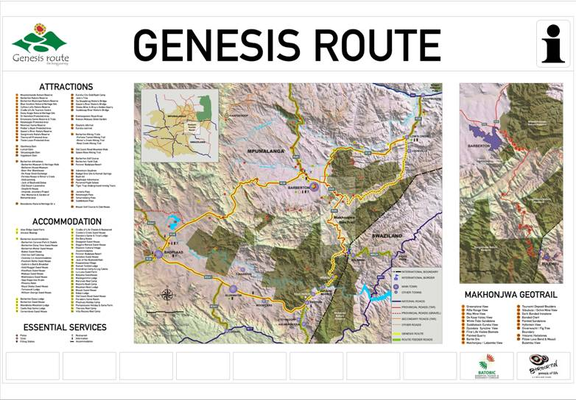

Slide 7
Makhonjwa Geotrail
ROUTE EXTENT:
20 Sites between Barberton & Bulembu:
  10x Geological Sites
  6 x view sites
  4 x geological & view sites
  13 require intensive development
  7 require only a signage plinth

Slide 8
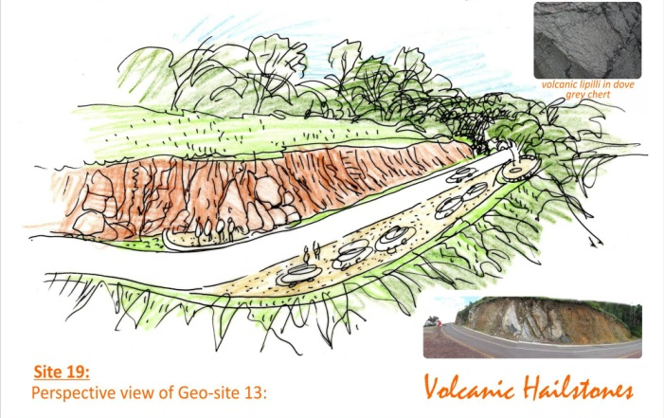
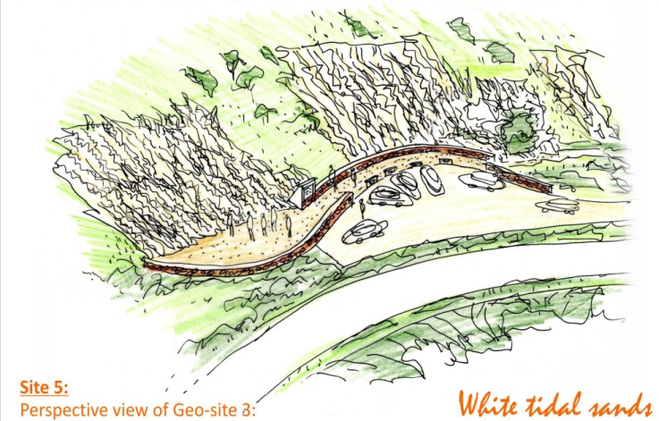
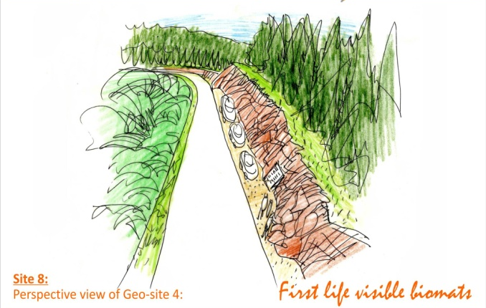
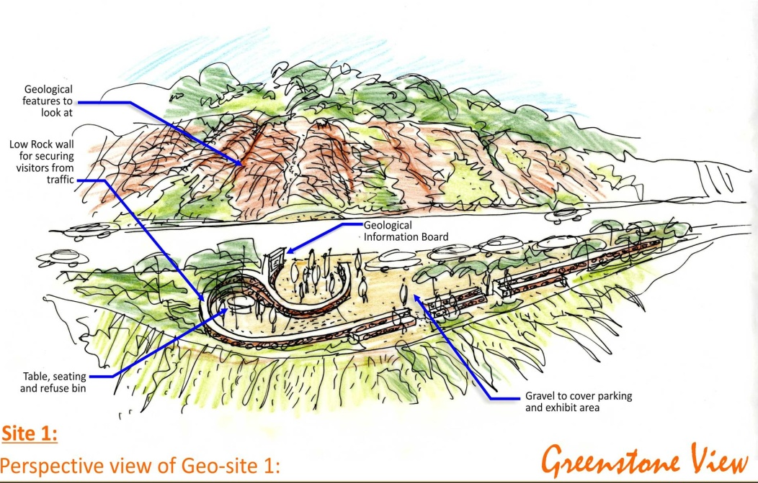
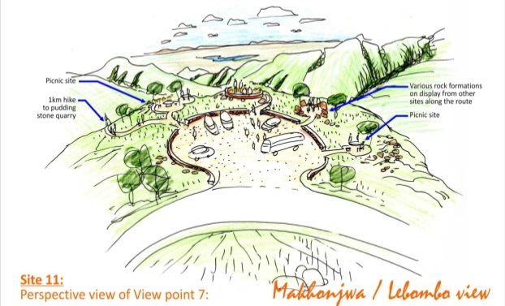
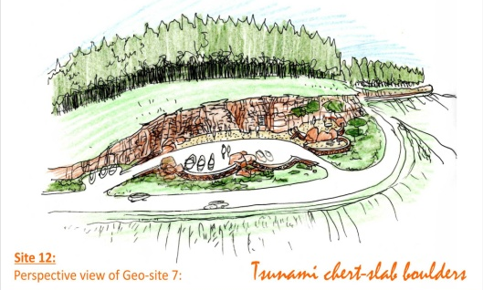
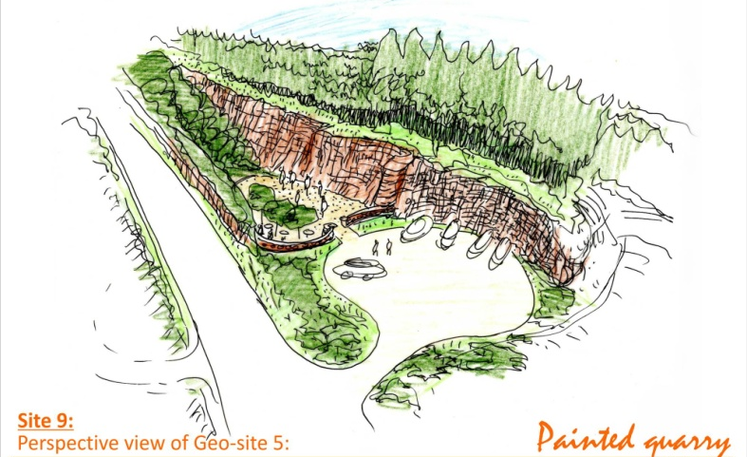
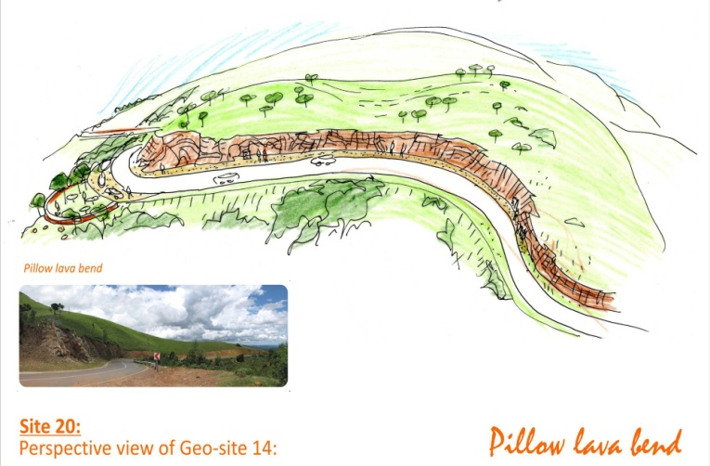
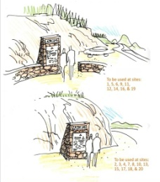
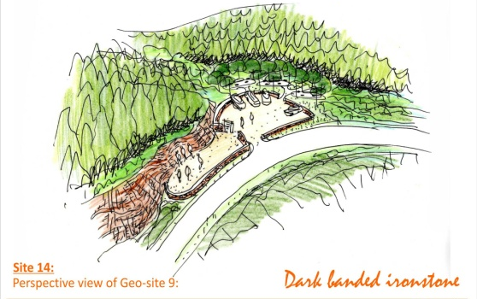
GEOSITES

Slide 9
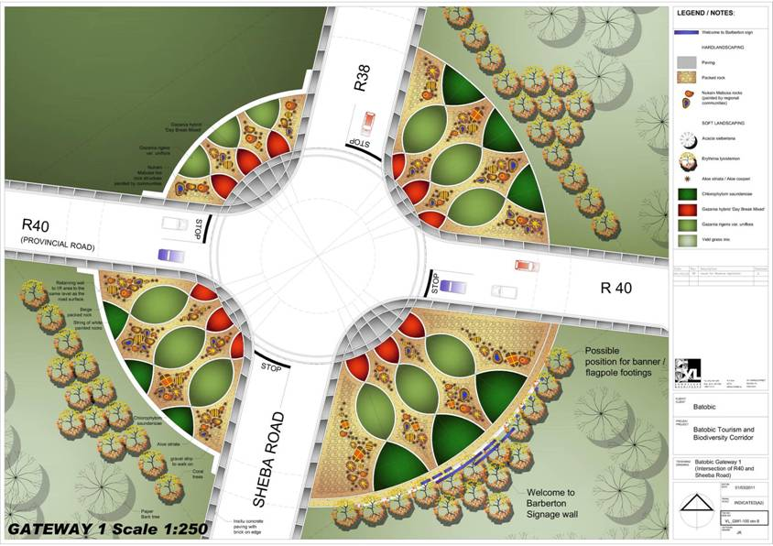
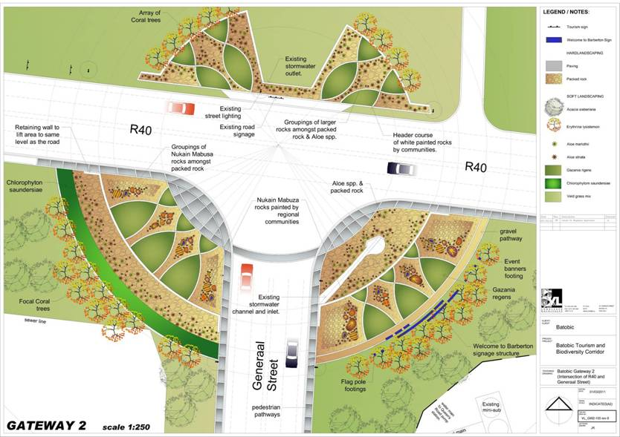
Barberton Gateways
SHEBA ROAD
GENERAAL STREET

Slide 10

Branding

Slide 11
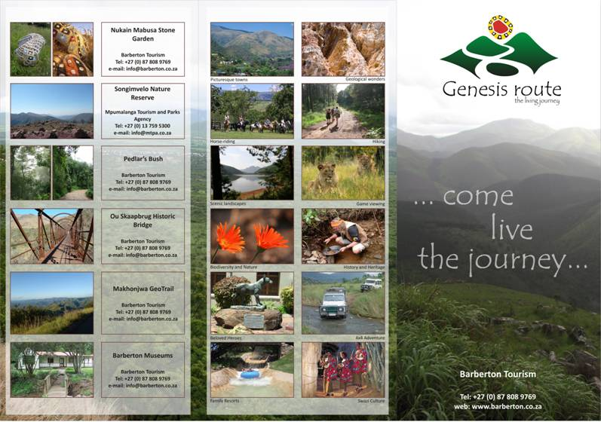
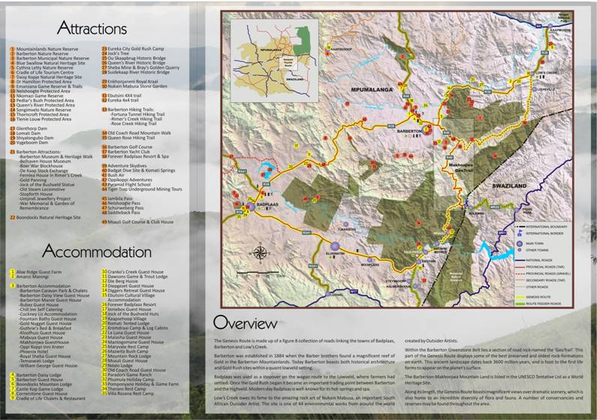
GENESIS ROUTE ‘Z’ FOLDER

Slide 12
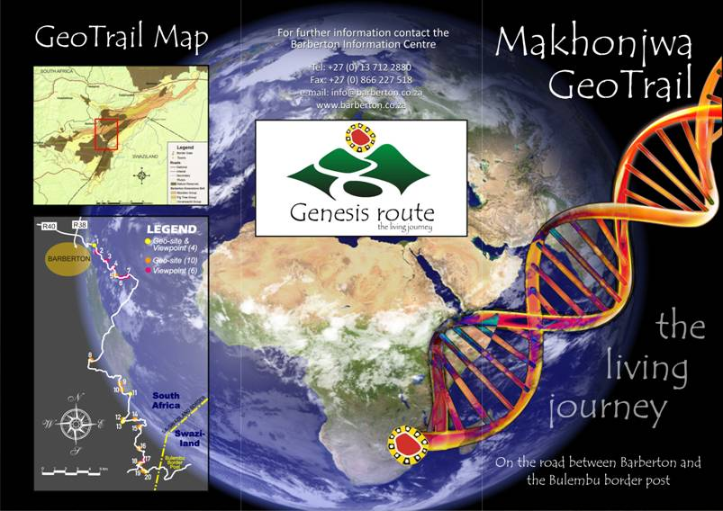
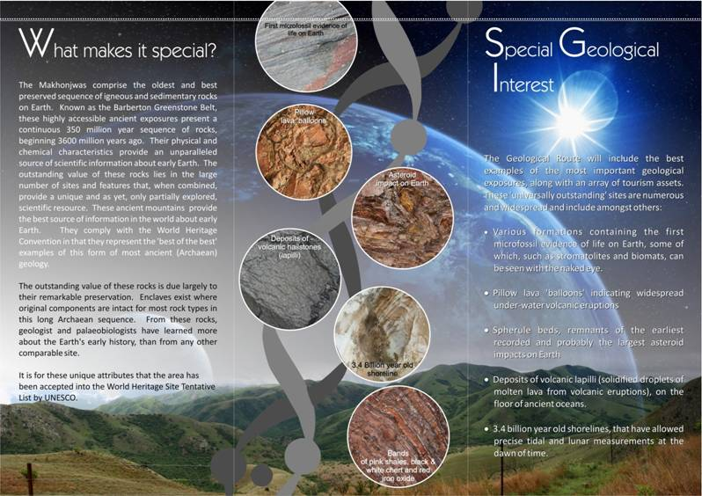
GEOTRAIL ‘Z’ FOLDER

Slide 13
Remaining challenges:

